Slide 1
Animal Nutrition Trials and Data Analysis
Dr. Shaukat Ali Bhatti
Institute of Animal Nutrition and Feed Technology
University of Agriculture, Faisalabad

Slide 2
Statistics
Research tool
Deals with the collection, organization, analysis, and interpretation of data.
Useful in drawing meaningful conclusions from a set of data
You can make the data look the way you like, if you know how to do it (misuse)
Should know why you are using?
Should have focused questions to answer
Don’t report all possible relationships among all treatments Graph
Just focus on objective questions
Don’t get biased to get ‘significant results’
Are we ready for that?

Slide 3
Focused questions
Does weaning age affect the growth of calves?
If yes, which weaning age is more economical?
Does milk replacer supports the same growth of calves as on milk?
Does better feeding during pre-weaning affects post-weaning performance of replacement heifers?
What is cost of veal production on different feeding regimens?
Can age at calving of buffaloes be reduced through better feeding and management?
What is growth rate of livestock on concentrate VS forage?
Is raising of livestock more economical on concentrates?

Slide 4
ANOVA
Analysis of Variance / Partitioning of variance
Understanding Variance:
All individuals in a population are not similar
They differ (VARY) from each other.
Population forms a bell shape curve
We want to know whether this dissimilarity (variation) is a chance variation or otherwise
Is this variation caused by other factors
Proportion of variation due to known variables is analysed
So we analyze the variation
We construct ANOVA for that

Slide 5
Example for understanding ANOVA
Milk production of cows ranged from 10-14 litres/day
Average = 12 litre/day
Offered Concentrate
Offered BST
Management improved
Milk production increased 16-20
Average: 18 litre/day
Difference: 18-12 = 6 litre
How much proportion of milk was improved due to
Concentrate?
BST?
Improved management?

Slide 6
Animal Nutrition Trials
Growth trials
Production trials
Digestibility trials (evaluation of feedstuffs)
Testing different treatments on any other aspect(s)
Basic research to understand mechanism of change?

Slide 7
Experimental Designs
Completely Randomized Designs (CRD)
Randomized Complete Block Designs (RCBD)
Latin Square Designs (LSD)
Factorial arrangements
Repeated measurements

Slide 8
Limitations of each Design
CRD
When experimental units are homogenous
Have less variation
Randomization carried out using Random Number Tables
RCBD
when experimental units can meaningfully grouped
Such groups are called blocks
LSD
Double grouping
Where two major sources of variation are present

Slide 9
Example I

Slide 10
Feeding Value of Urea Treated Wheat Straw Ensiled with or without Acidified Molasses in Nili-Ravi Buffaloes
Asian-Aust. J. Anim. Sci. 2006. Vol 19, No. 5 : 645-650
Five Diets
The control ration was balanced to contain 30% DM from UTWS ensiled without acidified molasses.
The other four diets were formulated to have 30, 40, 50 and 60% DM from UTWS ensiled with 6% acidified molasses
Data were analyzed using CRD
Question: Which inclusion level supports better milk production?

Slide 11
Example II

Slide 12
Effect of bST and Enzose on dry matter intake and production performance of buffaloes
EN: Enzose

Slide 13
Questions:
Does bST increase DMI and or milk production in buffaloes?
What is safe level inclusion level of Enzose in buffalo feeding?
Do bST and Enzose interact to influence DMI or milk production?
With simple CRD the above questions can’t be answered
Factorial arrangement is needed
Data analyzed using CRD in a 2 x 2 factorial arrangement

Slide 14
Enzose : P= 0.003
bST: P= 0.02
Interaction = 0.78
Does this graph answer my question?

Slide 15
Example III

Slide 16
Effect of different feeding regimens on the growth performance of Sahiwal Calves

Slide 17
Questions:
Is milk replacer cheaper to feed than milk in calves?
Is concentrate better when fed alone or with hay to pre-weaning calves?
Which single treatment combination is more economical than others?

Slide 18
STAT ANALYSIS
DIFFERENT OPTIONS:
CRD
Treatment I = Milk and SR
Treatment II = Milk and Hay
Treatment III = MR and SR
Treatment IV = MR and Hay
Birth weight as Covariance????
But with design I can’t answer my first two questions

Slide 19
RCBD
Milk and Milk Replacer
Sex as Blocks
If I know the sex had an effect and I want to exclude its effect
CRD
2 x 2 Factorial Arrangement
Factor I: Liquid Diet, Milk vs milk replacer
Factor II: Starter ration+ Hay vs Hay only
This design will answer all the posed questions

Slide 20
MAIN EFFECTS
Intake | Milk vs MR |  | SR+H vs Hay |  | F1 | F2 | F1*F2
 | Milk | MR | SR+H | Hay
Milk /MR (litre) | 217.5±1 | 184.5±1 | 209.9±1 | 192.0±1 | 0.001 | 0.7 | 0.8
SR (kg) | 25.0±2 | 22.1±2 | 23.6±2 | 0 | 0.36 | N/A | N/A
Hay (kg) | 21.3±1 | 18.4±1 | 17.8±1 | 21.9±1 | 0.08 | 0.001 | 0.4
Look: How my questions are answered from this Table?

Slide 21
Simple effects
Parameters | Milk vs MR |  | SR+H vs Hay |  | F1 | F2 | F1*F2
 | Milk | MR | SR+H | Hay
Total weight gain (kg) | 30.0 | 13.6 | 26.1 | 17.5± | 0.001 | 0.01 | 0.66
Total feeding cost (Rs) | 6935 | 3842 | 5878 | 4898 | 0.00 | 0.001 | 0.44
Feed Cost/kg (Rs) | 236 | 323 | 232 | 327 | 0.005 | 0.005 | 0.005
What does this Table tells me?
Which question is answered in this table?

Slide 22
Growth Trials

Slide 24
Repeated measure analysis
What does it mean?
When a reading is repeatedly taken on the same object/experimental unit
Each weight measurement is influenced not only by the treatments applied but also because of its previous weight
Other example
Taking blood sample from the same animal over different intervals (Hours of the day/ Days/weeks)
We use repeated measure analysis
Some journals require it; will not accept paper without it

Slide 25
Example IV

Slide 26
Effect of Intake level and forage source on kinetics of fibre digestion
J ANIM SCI 2008, 86:134-145.

Slide 27
Choice of experimental Design
Wanted to see the effect of
forage source and intake level
I had only four animals
So I had no choice except to use 4 x 4 Latin Square design
But also wanted to see the effect of forage source and intake level
2 x 2 factorial Arrangement with 4 x 4 LSD
Factor I: Forage Source
Factor II: Intake level

Slide 28
Example V

Slide 29
Effects of Varying Forage and Concentrate Carbohydrates on Nutrient Digestibilities and Milk Production by Dairy COWS
J Dairy Sci 1992, 75: 1533
Only Five Experimental animals
Five Experimental Diets
Cows were fed for five periods, each of which lasted 4 wk. The first 2 wk were for dietary adaptation
Use Latin Square
Possible in lactating animals, too

Slide 30
Example VI

Slide 31
Economic feasibility of raising Lohi sheep and Beetal goats for meat production under high input system
Effect of different protein levels on the performance of Lohi Sheep with or without ionophores and Probiotics
Treatments
Fodder
Concentrate
LP MP HP
With or without Ionophores
With or without Probiotics

Slide 32
Treatment Plan
Fodder |  |  |  | Ionophores |  |  | Probiotics
 | LP | MP | HP | LP | MP | HP | LP | MP | HP

Slide 33
How to analyze this data?
Analyze separately: delete Fodder and analyze the rest using 2 x 3 factorial design
Imbalance design?
CRD?
Nested design?
Focus on questions
Fodder Vs Concentrate
Ionophores vs probiotics
Concentrate vs Ionophores or Probiotics
Linear Response?
Quadratic Response?

Slide 34
Tired?
Looking at watches?
Let us conclude

Slide 35
As a Nutritionist you should know
What you want to do?
You can draw the desired conclusions by changing a design
Be confident
Remember to keep the design as simple s possible

Slide 36
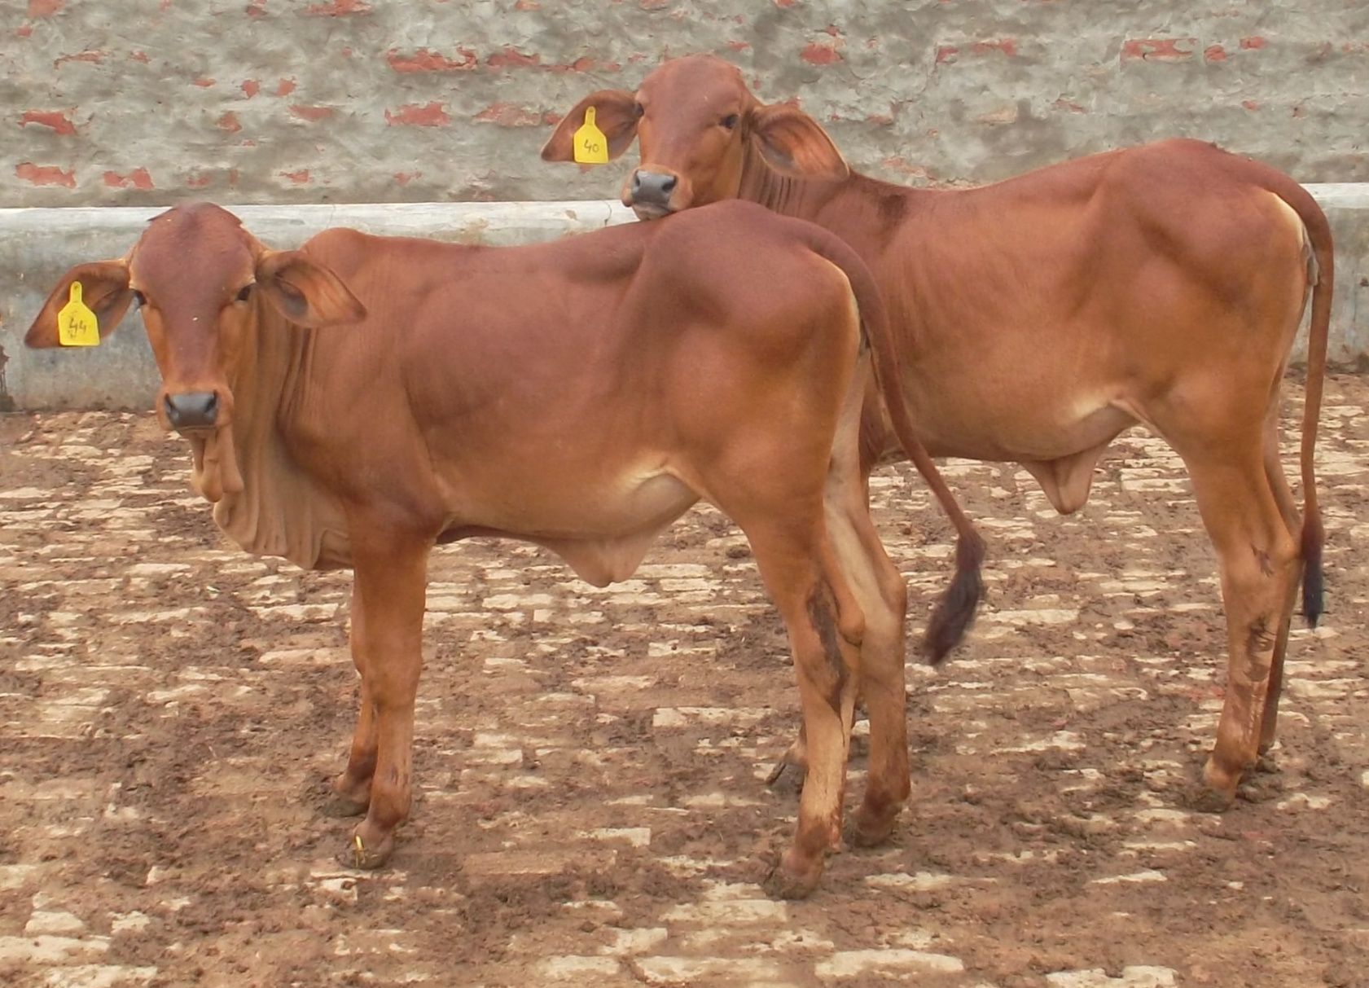
Hope it added to your knowledge

Slide 38
Additional slides

Slide 39
Back

Slide 40
Type I Error:
Rejecting the null hypothesis when it is true
Type II
Accepting the null hypothesis when it is false

Slide 41
Precision and accuracy
Precision
the magnitude of difference between two treatments that an experiment is capable of detecting at a given level of significance
Accuracy
The degree of closeness with which a measurement can be made
The measurement can be accurate but not precise
Examples: Watch, Balance, Any equipment that change its results with calibration

Slide 42
Standard Deviation and Standard Error of mean
Standard Deviation:
Average Squared Deviation: Variance
Root mean square Deviation:
Represented by small s for a sample and σ for a population
Deviation from mean of a Sample/ population

Slide 43
Standard Deviation of Mean or
Standard Error
Standard Deviation applies to observation and
Standard Error applies to means

Slide 44
Co efficient of variation:
A quantity used for evaluating results from different experiments

Slide 45
Regression
The magnitude of change in a dependant variable as a result of per unit change in an independent variable
Or
Increase of decrease in a dependant variable as a result of per unit increase or decrease in an independent variable
Example: FCR
Correlation:
Measurement of relationship between two variables
Relationship could be positive or negative

Slide 46
ANOVA vs GLM
ANOVA is used for balanced designs
GLM is used for unbalanced designs
Balanced vs unbalanced
An experimental design is called unbalanced if the sample sizes for the treatment combinations are not all equal
Reasons why balanced designs are better:
The test statistic is less sensitive to small departures from the equal variance assumption.
The power of the test is largest when sample sizes are equal.
Why to work with unbalanced designs:
Balanced designs produce unbalanced data when something goes wrong. (e.g. the animal dies or you get some negative values in your data.)

Slide 47
ANOVA for CRD
When we have 4 treatments and 4 replicates
Source of variation | Degree of freedom | Degree of freedom
Treatment | (t-1) | 3
Error | t(r-1) | 12
Total | (n-1) | 15

Slide 48
ANOVA for RCBD
When we have 4 treatments and 4 replicates
Source of variation | Degree of freedom | Degree of freedom
Treatment | (t-1) | 3
Blocks | (b-1) | 3
Error | (t-1)(b-1) | 9
Total | (n-1) | 15

Slide 49
ANOVA for 2 x 2 factorial arrangement
When we have 4 treatments and 4 replicates
Source of variation | Degree of freedom | Degree of freedom
Treatment | (t-1) | 3
Factor A | (a-1) | 1
Factor B | (b-1) | 1
A x B | (a-1)(b-1) | 1
Error | ab(r-1) | 12
Total | (n-1) | 15

Slide 50
ANOVA for factorial experiment
Two factor factorial 2 x 2 with 12 replicates each
Source of variation | Degree of freedom | Degree of freedom
Factor A | (a-1) | 1
Factor B | (b-1) | 1
Interaction AB | (a-1)(b-1) | 1
Error | ab(r-1) | 44
Total | (n-1) | 47

Slide 51
ANOVA for Latin Square Design
When we have 4 treatments and 4 replicates
Source of variation | Degree of freedom | Degree of freedom
Treatments | (r-1) | 3
Blocks (animals) | (r-1) | 3
Periods | (r-1) | 3
Error | (r-1)(r-2) | 6
Total | (n-1) | 15

Slide 52
ANOVA for Latin Square Design
Four treatments and 4 replicates with 2 x 2 factorial arrangement
Source of variation | Degree of freedom | Degree of freedom
Treatments | (r-1) | 3
Factor A Factor B A x B | (a-1) (b-1) (a-1)(b-1) | 1 1 1
Blocks (animals) | (r-1) | 3
Periods | (r-1) | 3
Error | (r-1)(r-2) | 6
Total | (n-1) | 15

